Slide 1
Burlingame’s Citywide
Disaster Response Drill
Walk-Through
Drill Date: Saturday, October 8, 2022

Slide 2
Agenda
1. Exercise Overview
2. Drill Kit-in-a-Box and Caches
3. Setting up Your Drill
4. Communications Overview
5. Mock Drill Video
6. Q & A
Reminder – please have at least one block representative join:
Communications Workshop
Thursday September 29th Zoom, 7-8 pm

Slide 3
Blocks all over town will run the drill simultaneously
Saturday morning October 8, 9-10:30am

Slide 4
Drill Prep in 7 Easy Steps!
1-2 weeks before the Exercise
✔️ Attend tonight’s Drill Walk-Through
Recruit neighbors (we have tools to help: sample flyers, emails, lawn signs)
Your Drill Kit - review materials (new Kit, or Refresh Kit, this includes step-by-step directions, scenarios you can choose, a script and more!)
Continue recruiting neighbors (drill needs 8 people minimum)
ID your key roles, Incident Commander, Communications Lead
Send reminder email to your neighbors (1-2 days before)
Drill Day! Plant scenario flags, set up Incident Command post.
BurlingameNetwork.org
> Resources tab
> Drill Materials tab
> Drill Lead Resources

Slide 5
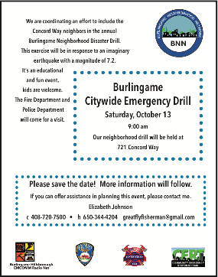
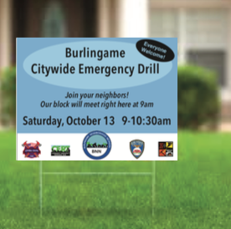
2. Recruit neighbors
Tools to help you promote the drill on your Block
A minimum of 8 participants are needed to hold a drill
Sample Flyers
Sample Email reminder (includes asking neighbors to arrive a bit early at 8:45)
Lawn Signs
BurlingameNetwork.org
>Resources tab
>Drill Materials tab
> Drill Lead Resources

Slide 6
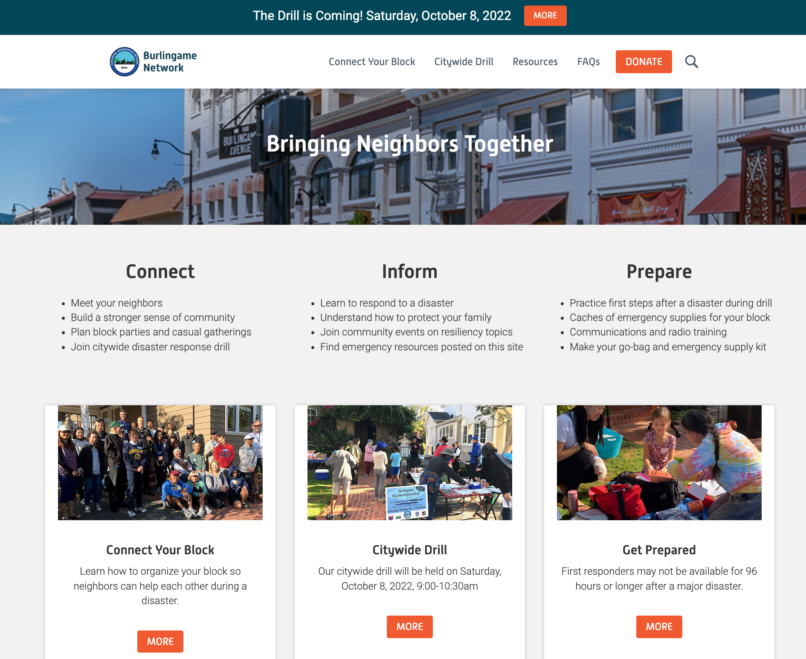
Recruit neighbors
Tools to help you promote your block drill on BurlingameNetwork.org
BurlingameNetwork.org
>Resources tab
>Drill Materials tab
> Drill Lead Resources

Slide 7
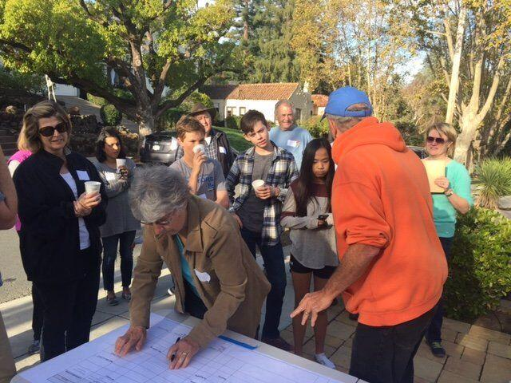
Mock Drill 8-Minute Video
Let’s see how a drill will play out!

Slide 8
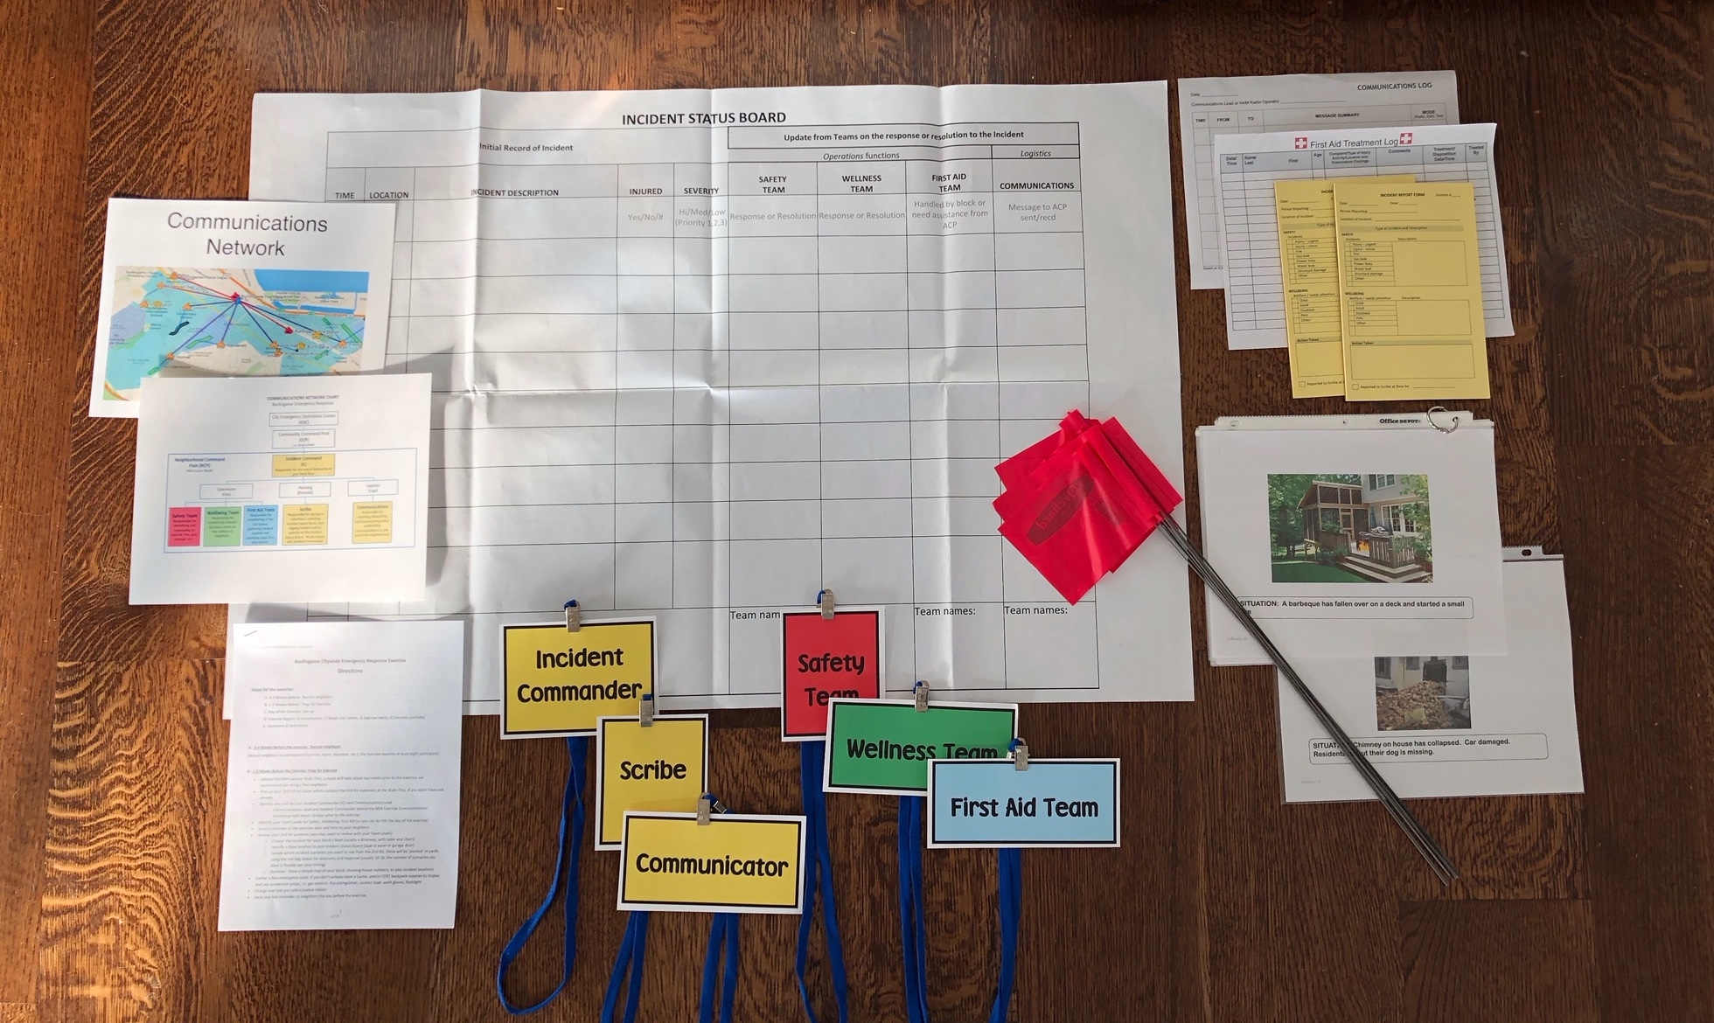
3. Your Drill Kit-in-a-Box
Kit + Lawn Sign + Radio delivered to Leads this week.
Your Drill Kit-in-a-Box contains all needed materials, which we will review tonight:
Directions
Charts and Forms
Scenarios/Flags
+ more
Drill Refresh Kits
If you have run the drill before, you will receive a Drill Refresh kit which replaces items you used
up last time.
Drill Kit-in-a-Cache
If your block has a Cache, it contains all Drill materials within the duffle bags.

Slide 9
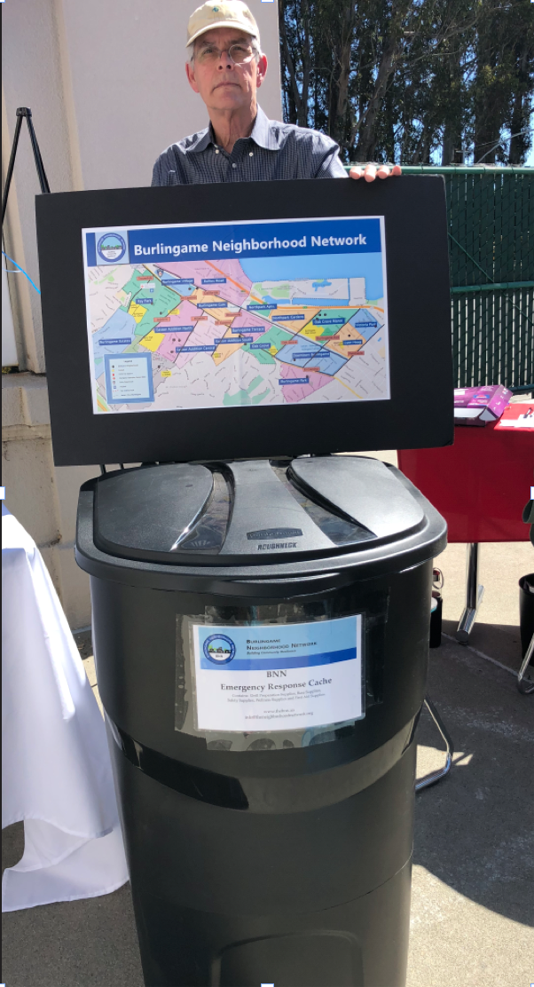
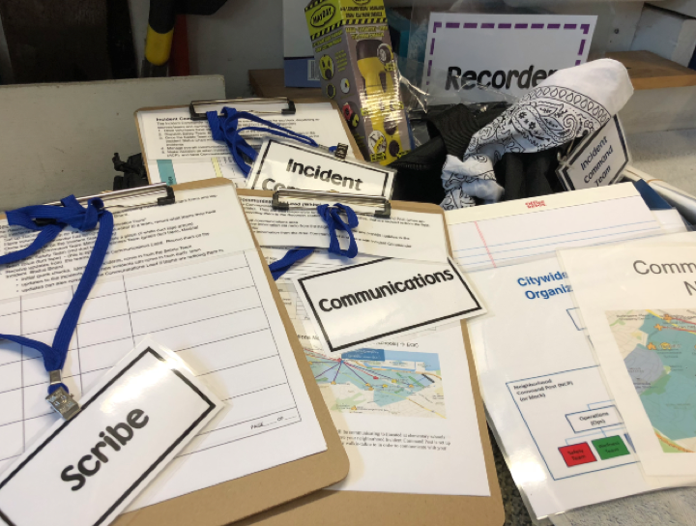
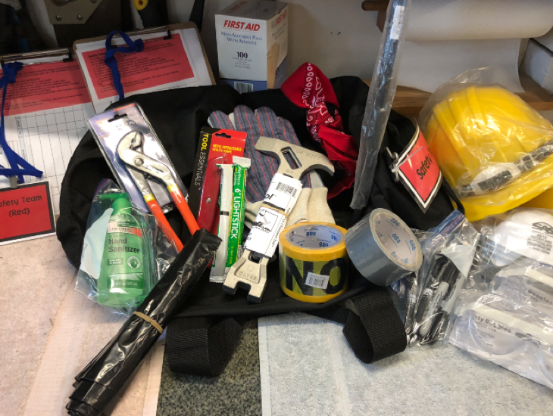
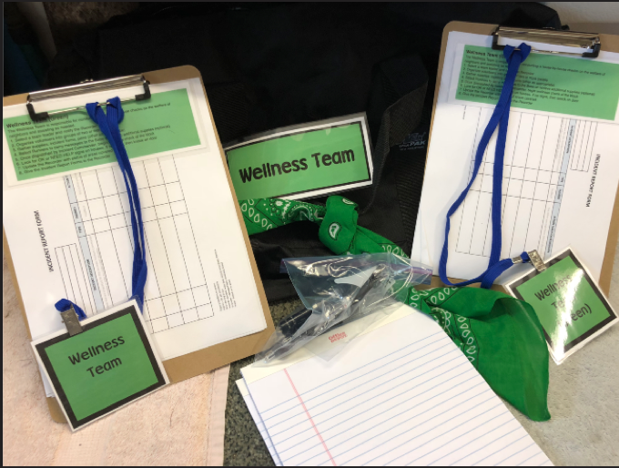
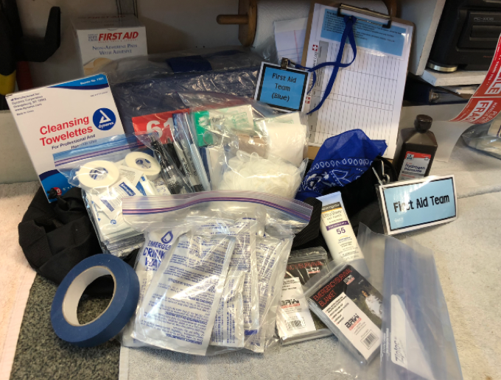
BNN’s Emergency Cache Program
Active blocks can apply for a Cache filled with tools and equipment, valued at over $600, to store in their neighborhood for use in a real emergency.
Caches also contain Drill Kit materials, for your use in the Drill or real emergency.

Slide 10
Drill Kits – Team Roles
The Drill uses a 4-team approach to organize for emergency response.
Your Kit materials are team-coded by color.
*
Incident Command
(IC)
Safety
Wellbeing
First Aid

Slide 11
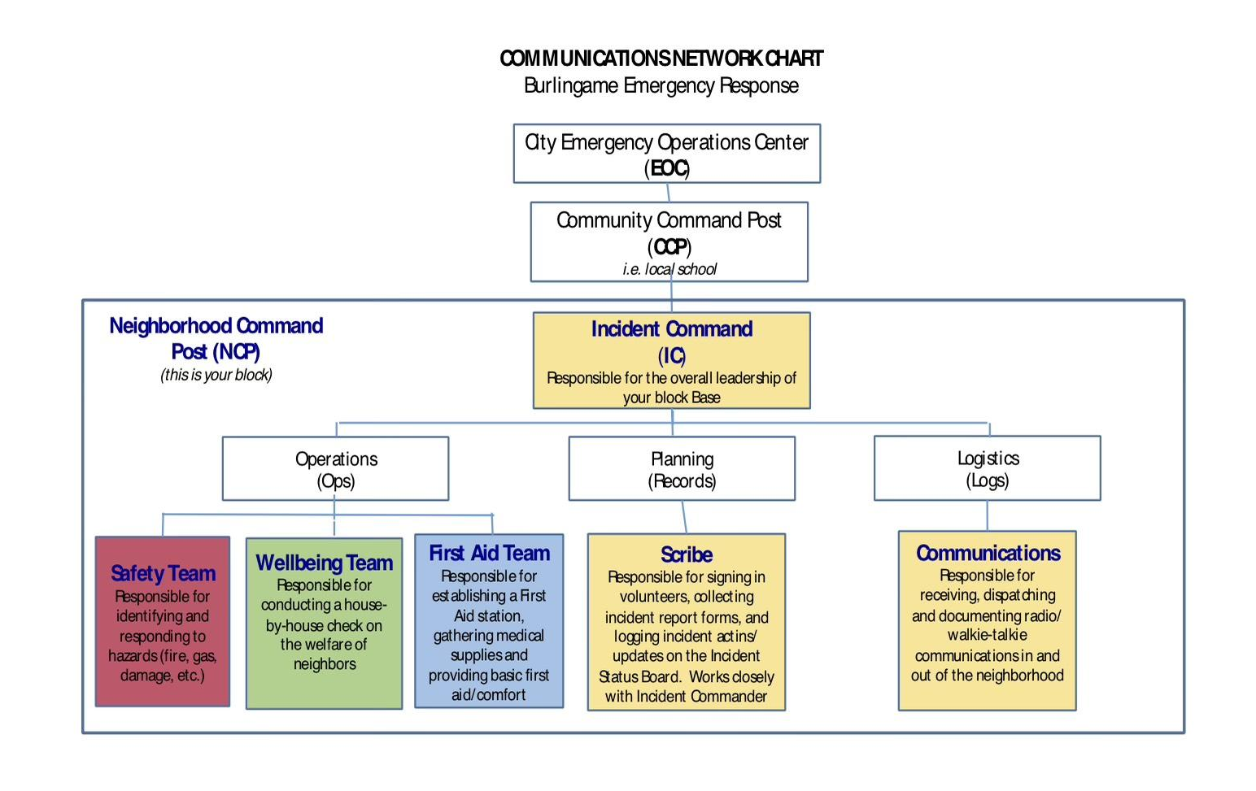
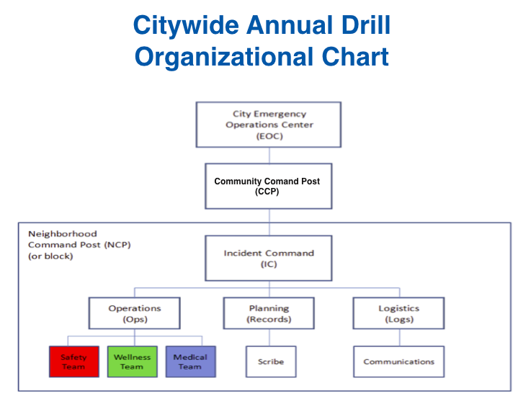
Tracking with FEMA’s general emergency framework
This Communications Network Chart (in Drill Kit) is helpful to post.
Each Block (NCP) will assign a lead for each key Block role (in color)

Slide 12
5. Please Identify your Incident Commander (IC) in advance
Identifying the Communications Lead in advance is also helpful, to attend the Comms Workshop
You may ID other Team Leads in advance or ask for volunteers as participants arrive.
Neighborhood Command Post
NCP (your block)
Incident Command (IC)
Responsible for the overall leadership of your block Base
Safety Team Lead
Responsible for identifying and responding to physical hazards (fire, gas, damage)
Wellbeing Team Lead
Responsible for conducting a house-by-house check on the welfare of neighbors
Scribe
Responsible for signing in volunteers, collecting incident report forms, and logging incident actions/updates on the Incident Status Board. Works closely with Incident Commander
Communications
Responsible for receiving, dispatching and documenting radio/walkie-talkie communications to and from the neighborhood
First Aid Team Lead
Responsible for establishing a First Aid station, gathering medical supplies and providing basic first aid/comfort
Blocks will setup an Incident Command station, also called an NCP. This station is your block’s base and is comprised of six key roles.

Slide 13
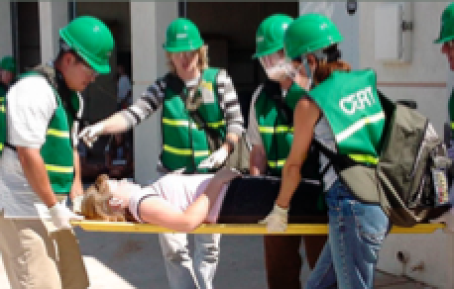
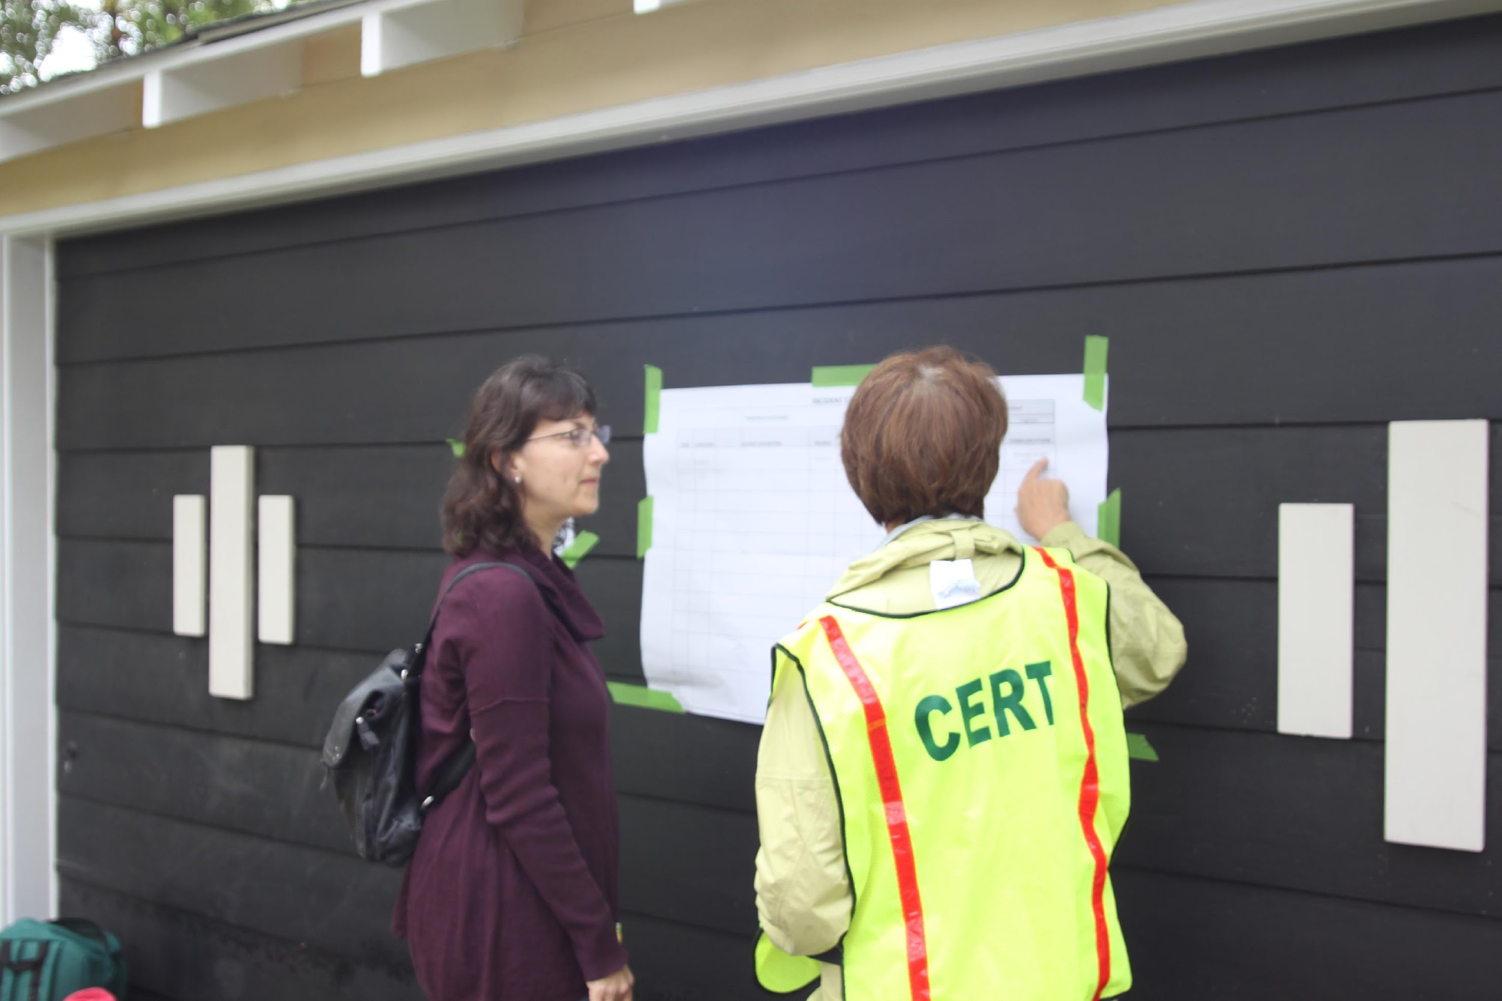
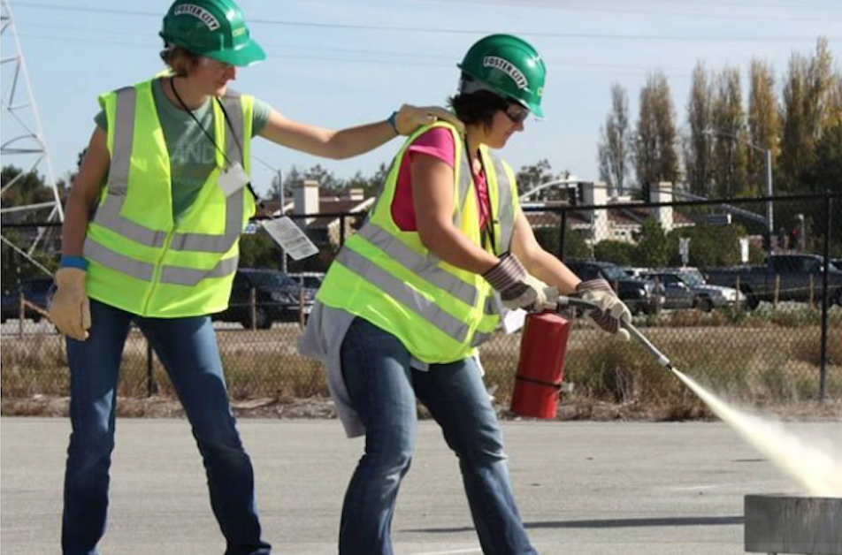
Burlingame CERTs
Community Emergency Response Teams
We are happy to have CERTs participate in the BNN Exercise!
CERTs are volunteer residents with Fire Department training.
If you have any CERT participants in your drill, they may be good Team Leads for your block.
f

Slide 14
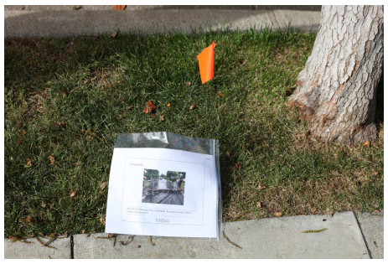
Select Your Incident Scenarios
+ New Critical Scenarios
A set of Incident Scenario pages + flags are in your Drill Kit box.
In advance, choose 8-10 scenarios you like.
Then, on the morning of the drill, plant them on various front lawns on your block.
To promote a full-group discussion:
Two Critical Incident Scenarios are added to the Kit, however, they are not for planting.
The IC will set these two aside to use for a full group discussion at the IC base with all participants, later in the drill.
The IC or Scribe will announce these two Critical Scenarios and invite group brainstorming for response ideas. (If needed, discussion prompts are on the back.)
Note: These Critical scenarios were added because input from prior drills requested more opportunity for conversation among all participants.
.

Slide 15
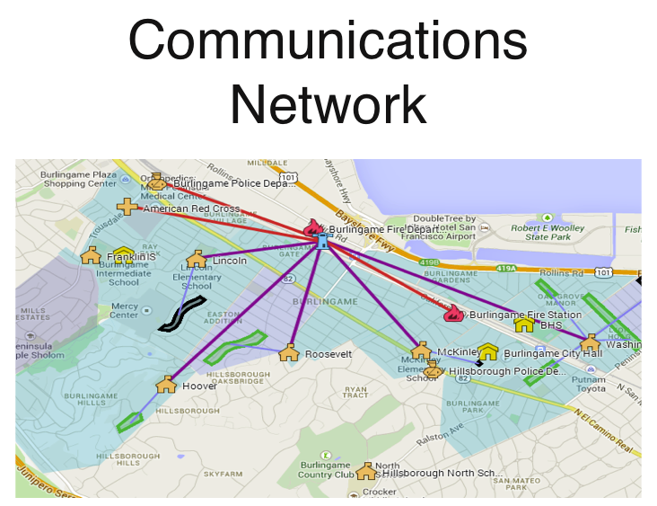
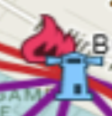
Communications: How to escalate critical incidents for help!
Only a few incidents are critical to life or property, requiring radio calls for outside help.
CCP =
NCP = Your Block
EOC =

Slide 16
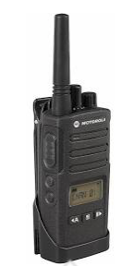
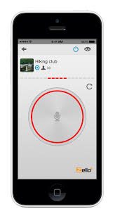
Communication Options for Blocks during the Drill
2-watt FRS radios provided by BNN, or Ham radios
Call or Text
(if cell towers work and mobile #s are known)
Runners to CCP
Zello App if you have this set up already

Slide 17
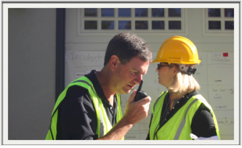
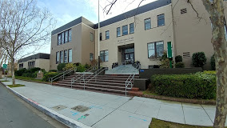
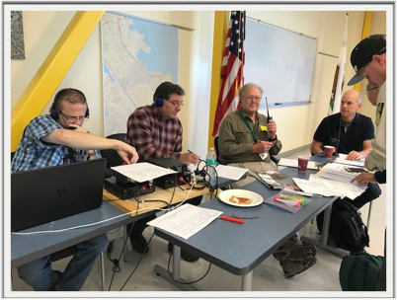
Communications Routing
NCP < > Hams at CCP < > Hams at EOC
NCP Communication Lead (Neighborhood Command Post- blocks)
Block Comms Leads radio critical incidents to Hams at CCP (school) via:
- assigned radio channel
- text
- runner
Hams posted at CCP (Community Command Post - schools)
Hams at CCP relay communications to / from the EOC
Hams at EOC (Emergency Operations Center - CCFD/Rollins Road
EOC prioritizes incidents, and dispatches first responders as able
EOC may also dispatch updates, alerts, evacuation orders.

Slide 18
Drill Set-up
Morning of the Exercise: 8 - 9 am
1. Plant Scenario flags on random front lawns on your block
2. Set up your NCP: table, chair, drill kit materials
3. Tape up charts and set out any display tools
4. Name tags, Sign-in

Slide 19
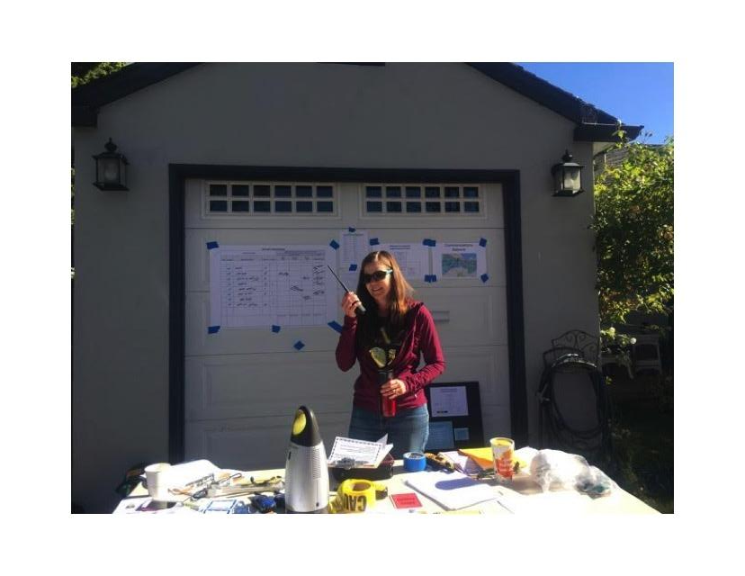
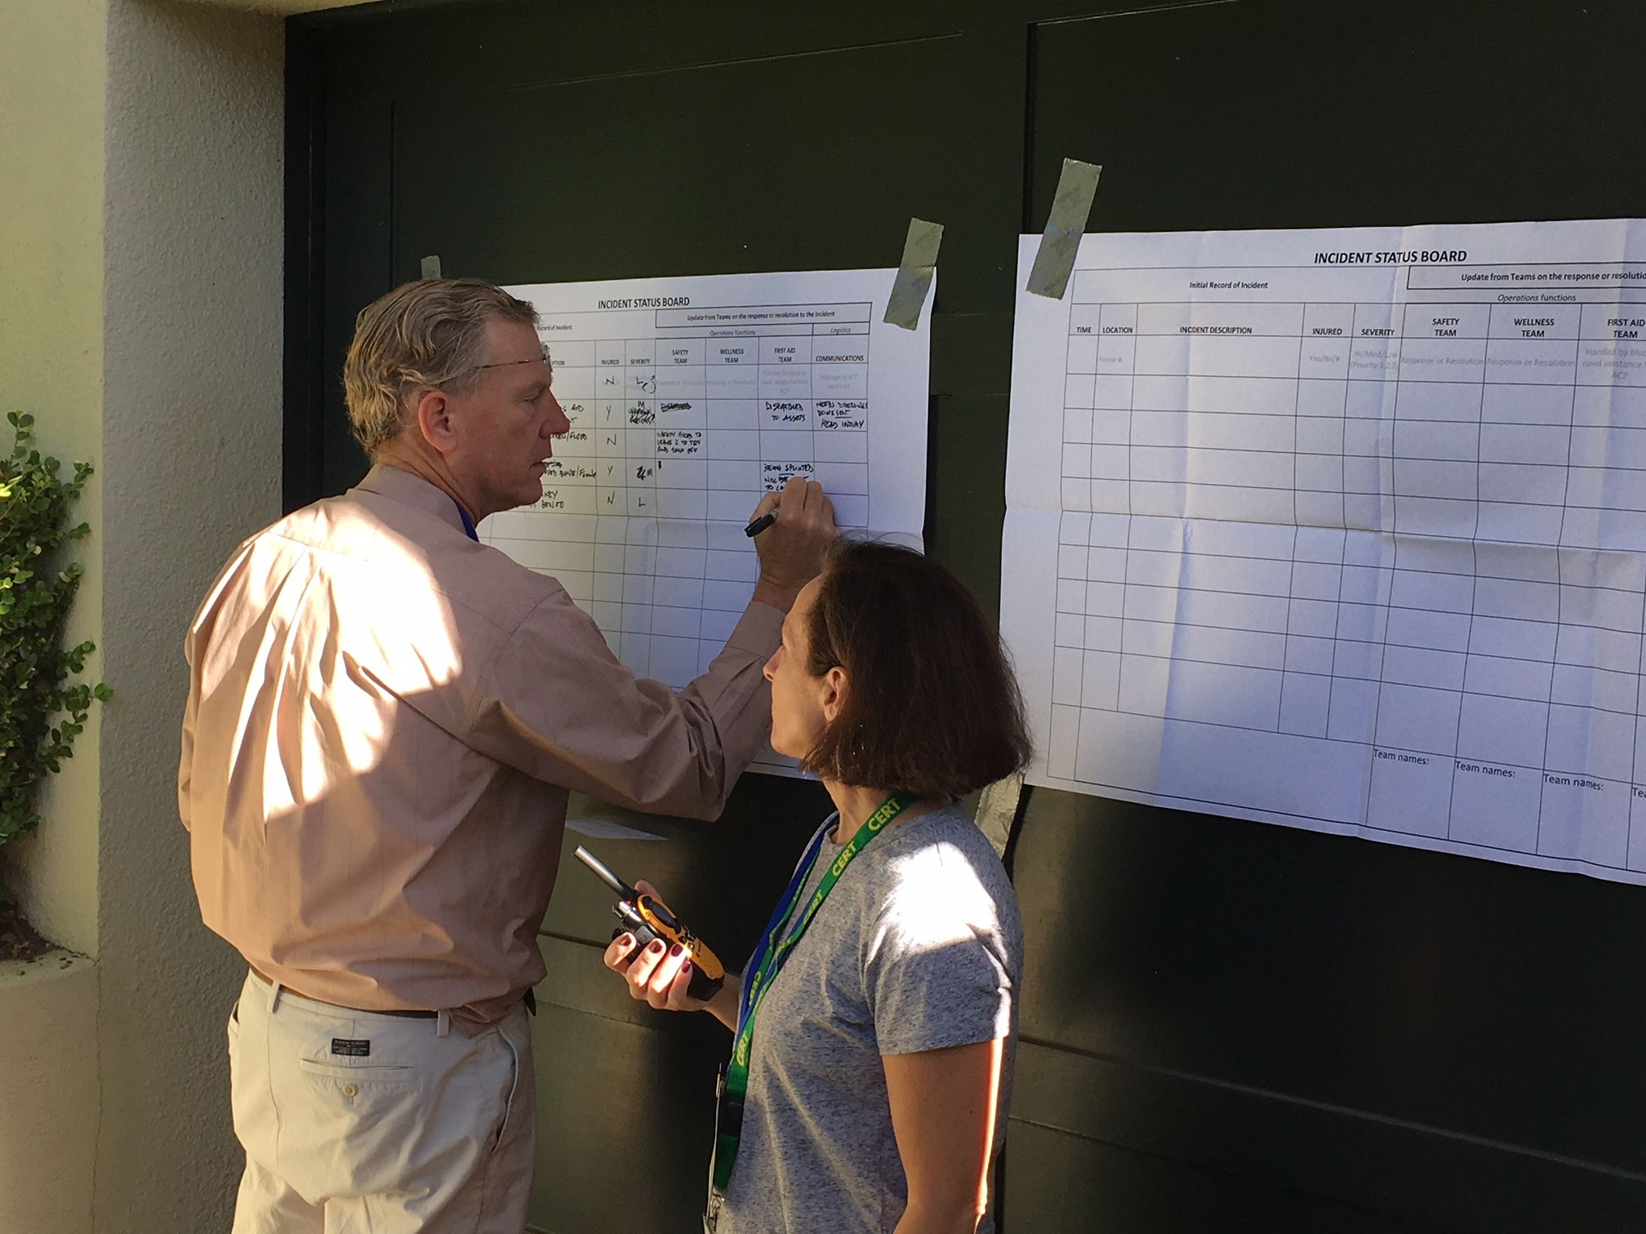
Neighborhood Command Post (NCP) Examples
Fire, Police, City official visits are available per Department schedules that day.
To add your block to their visit list, email info@BurlingameNetwork.org

Slide 20
Let the Exercise Begin!
9:00 am
As neighbors arrive:
Welcome participants, sign-in & name tags
Identify Team Leads, give them their Team Description cards to review
SMC Alert text - this will be sent to announce the drill
Begin drill: Read aloud the bold font ‘script’ from Drill Instructions pg.3-5
Dispatch Teams to sweep for flagged scenarios and fill out report forms

Slide 21
The Drill Begins
To begin the drill:
Use the script (bold) in your Drill Kit Instructions.
Your block’s Incident Commander will read the script to begin the exercise.
Announce Incident
”This morning we experienced a
magnitude 7.4 earthquake . . . “

Slide 22
Q & A
We are happy to answer your questions!
Please post your questions in the chat room.
Joe Becerra
Beth Bhatnagar
Holly Daley
David Harris
Anne Hinckle
Rik Kasuga
Dee Kumar
Terry Nagel
Valerie Tucker
BurlingameNetwork.org
info@BurlingameNetwork.org
Thank You
for making Burlingame a resilient community!

